Slide 1
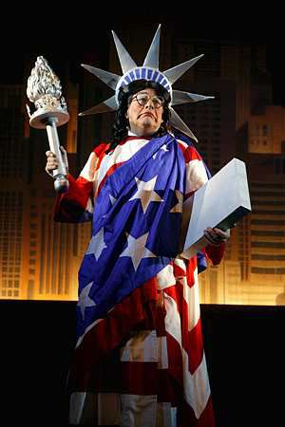
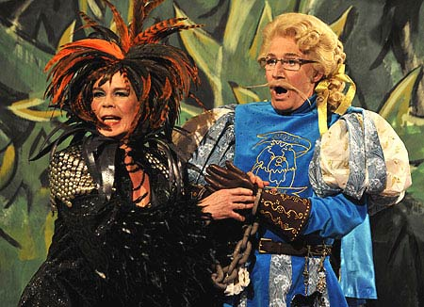
PANTOMIME
Yr 7 Drama
Lesson 3
Creating a Scene

Slide 2
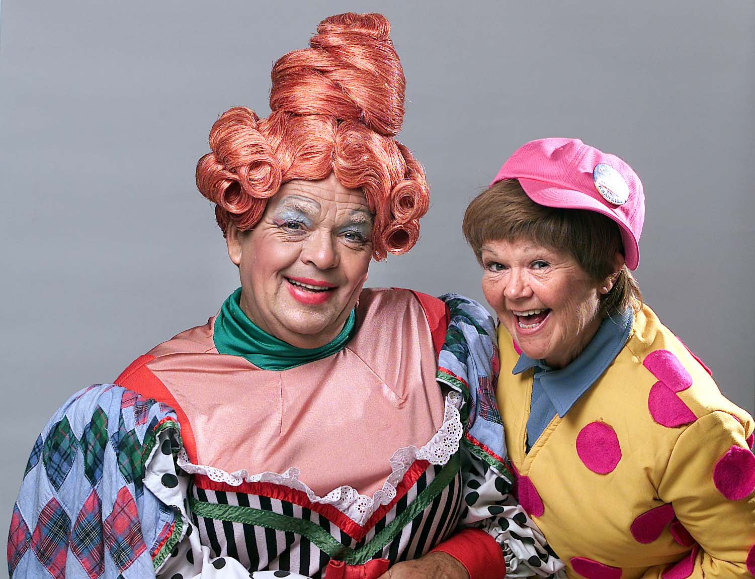
RANDOM REGISTER
In true Pantomime style let’s answer the register with an unusually large and exaggerated performance.
You can say “Yes Sir” any way that you like but you must stand up and add a very large and over the top gesture!

Slide 3
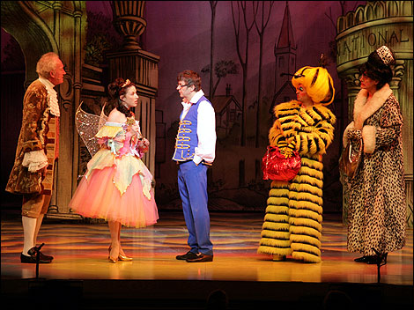
LESSON OBJECTIVE
To ‘Create a Scene’ from a pantomime

Slide 4
Level | Drama Strand
 | Creating | Performing | Reflecting
Entry | I can take part in a drama activity | I can participate in part of a group performance | I can identify positive and negative aspects within my work
1 | I can take part in a range of drama activities I can explore problems in an imagined world and make up plays from stories or other stimuli | I can participate in a short group performance I show some consideration of movement and voice in performance | I can make simple connections between the dramas I experience and my own life I can recognise when my own work and the work of others’, could be improved
2 | I can perform my own simple scenes, demonstrating an understanding of drama techniques | I can use my voice and body to create a simple character I can act out improvised dramas | I can talk about why I made certain decisions in my play I can show a basic understanding of how meaning can be shown
3 | I can establish a character with control over movement and voice I can use the dialogue in existing texts as well as creating my own I can devise plays from a range of stimuli I can respond to the use of drama techniques to deepen the role or understanding of the situation e.g. hot seating I can sustain a defined character for a reasonable amount of time | I can learn lines and organise simple performances | I can give suggestions on how work could be improved I can talk about my work using some technical drama terminology I can discuss and give reasons for my preferences in the drama I have seen

Slide 5
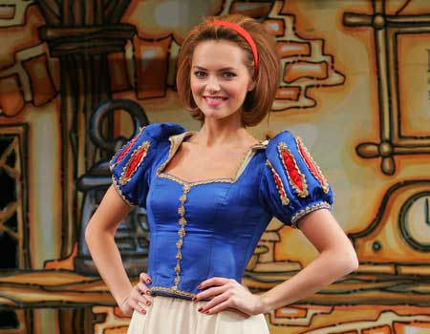
10 MINUTE RECAP
Lesson Objective:
To ‘Create a Scene’ from a pantomime
To understand how to successfully perform a pantomime scene.
You have 10 minutes to recap the routines and gags you learnt in the last lesson.
THE SCARY WALK
COME HERE-WALK AWAY
SQUEEKY SHOE
SSSH SILENT WALK.
THE DESCRIBING WALK!
THE LOOK
REPEATING GAG

Slide 6
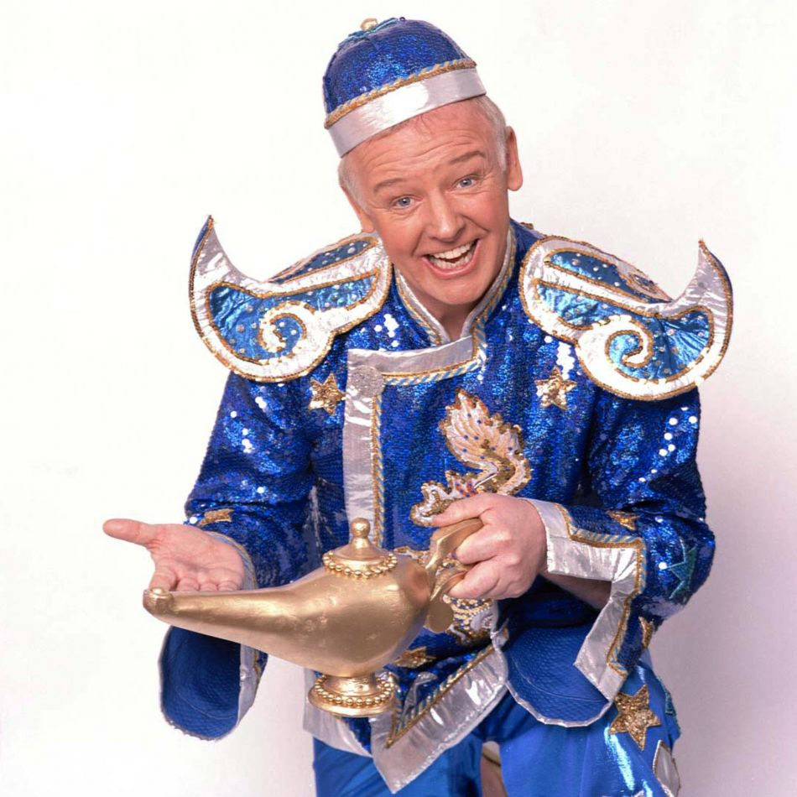
2 NEW ROUTINES
Lesson Objective:
To ‘Create a Scene’ from a pantomime
To understand how to successfully perform a pantomime scene.
CUT YOU INTO PIECES
CHOCOLATE GAG

Slide 7
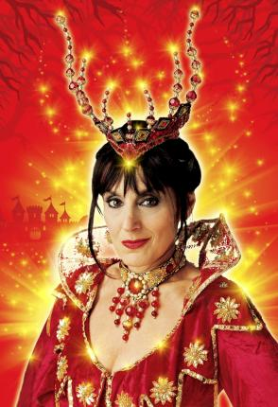
MAKING A SCENE
Lesson Objective:
To ‘Create a Scene’ from a pantomime
To understand how to successfully perform a pantomime scene.
Let’s make a scene, good options are…
The baddie and their sidekick
The Principle Boy and the comic
Or create a scene using your own choices of Stock Characters.

Slide 8
THE TASK
Lesson Objective:
To ‘Create a Scene’ from a pantomime
To understand how to successfully perform a pantomime scene.
You must create and perform a panto scene.
THE CHOICES…
Ask Sir for a pre written scene which involves a routine or gag.
Ask Sir for the structure of a scene and then add your own dialogue(words)
Create your own scene with a routine or gag.

Slide 9
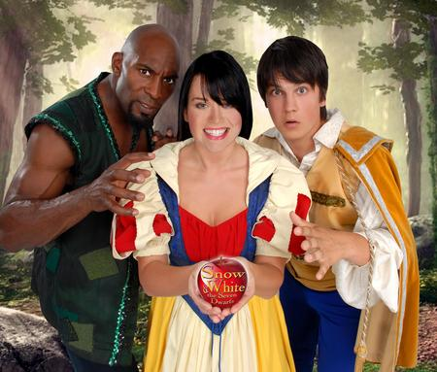
SPOTLIGHT
Lesson Objective:
To ‘Create a Scene’ from a pantomime
To understand how to successfully perform a pantomime scene.
Let’s spotlight your work
REMEMBER…
What Went Well
Even Better If?

Slide 10
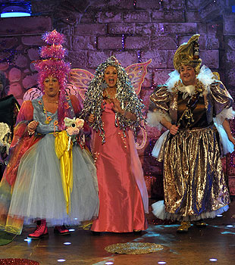
WHAT DID YOU ACHIEVE TODAY?
Lesson Objective:
To ‘Create a Scene’ from a pantomime
To understand how to successfully perform a pantomime scene.
Summing up:
What have you learnt today?
What level have you achieve and how/ why?
What do you need to do to meet your target grade?
Get into a pair.
Share your knowledge and ideas with your partner

